Slide 1
Learning Compact Binary Face Descriptor for Face Recognition
Batch :17
Guide: Presented By:
Sri. G.Srinivasa Rao Ch. Leela Sai Manohar( Y22IT018)
Associate Professor A.Karthikeya(Y22IT006)
J.Deepika (Y22IT045)
B.Deepa(Y22IT013)

Slide 2
Contents:
Problem Statement
Proposed Method
Algorithm & Block Diagram
Results
Conclusion

Slide 3
Problem statement:
Face recognition systems face challenges from variations in pose, illumination, expression, and modality, limiting traditional methods like LBP in unconstrained environments. The aim is to develop a robust, compact, automated feature learning approach for improved face recognition performance.

Slide 4
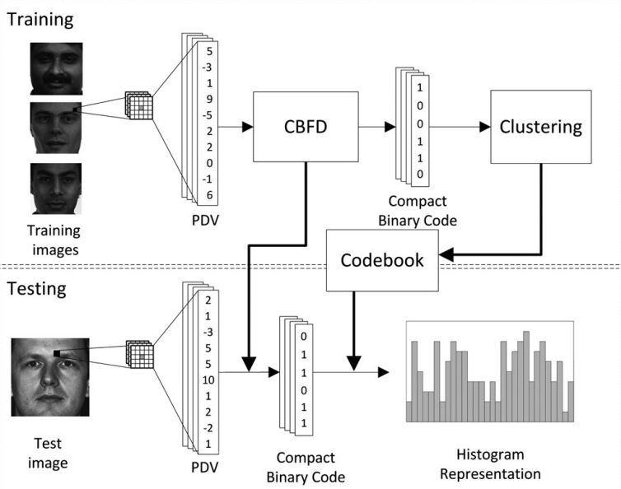
Block Diagram for Proposed CBFD:

Slide 5
Proposed Method:
Compact Binary Face Descriptor (CBFD)
Coupled-Compact Binary Face Descriptor(C-CBFD)

Slide 6
Compact Binary Face Descriptor (CBFD)
The Compact Binary Face Descriptor (CBFD) is proposed to improve face recognition by transforming pixel differences into binary feature vectors that are compact, discriminative, and computationally efficient.
CBFD Feature Learning:
1. Extract Pixel Difference Vectors (PDVs)
Pixel intensity differences between a pixel and its neighboring pixels are computed to capture local texture variations for better face representation.
2. Transform PDVs into Binary Features
The extracted PDVs are mapped into a binary feature space using a learned transformation, ensuring compact and efficient face descriptors.

Slide 7
3. Optimize the Binary Feature Space
The transformation process is optimized to maximize variance, minimize quantization loss, and ensure a uniform binary code distribution.
4. Advantages of CBFD Feature Learning
CBFD provides a compact, efficient, and robust face representation while eliminating the need for handcrafted features.

Slide 8
CBFD-Based Face Representation
Once the binary codes are learned, they are used to create a histogram-based face representation for recognition.
Steps in CBFD Face Representation:
Cluster binary codes using K-means to form a codebook.
Construct a histogram feature by counting occurrences of binary patterns.
Divide the face image into local regions and extract CBFD for each region.
Concatenate region-based histograms to form the final face descriptor.
Apply PCA (Whitened PCA - WPCA) to reduce dimensionality.

Slide 9
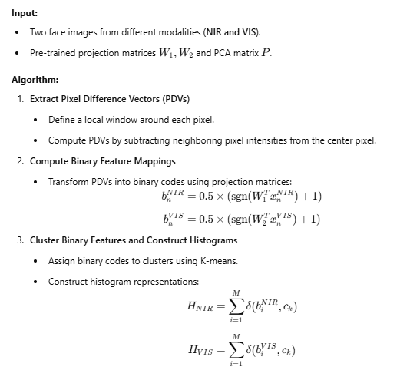
Algorithms:

Slide 10
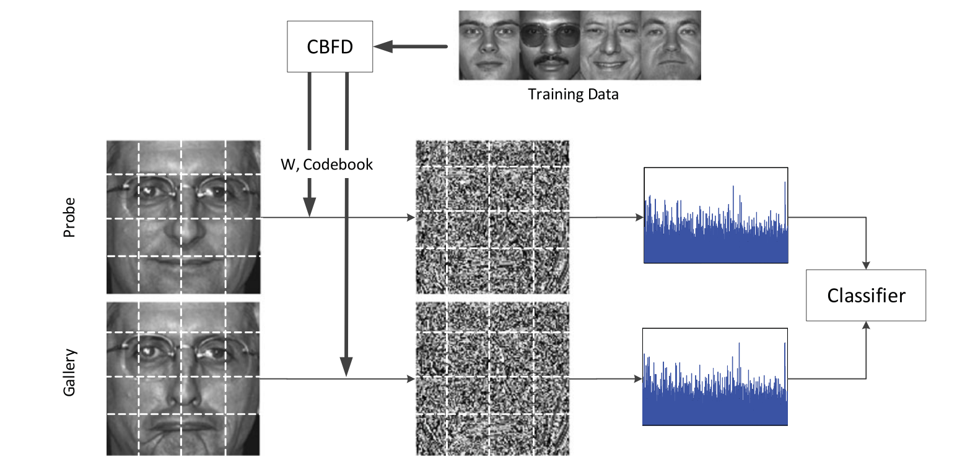
Block Diagram of the how CBFD is used for face representation:

Slide 11
Coupled CBFD:
The Coupled CBFD (C-CBFD) is an extension of CBFD designed for heterogeneous face recognition, such as matching Near-Infrared (NIR) images with Visible (VIS) images. Since NIR and VIS images have different feature distributions, C-CBFD minimizes the modality gap between them.
Steps in C-CBFD:
Extract PDVs separately for NIR and VIS images.
Learn separate binary feature mappings for NIR and VIS using different transformation matrices.
Construct modality-specific histograms for both NIR and VIS images.
Apply Whitened PCA (WPCA) to align NIR and VIS feature spaces.
Compare transformed features using cosine similarity to determine identity.

Slide 12
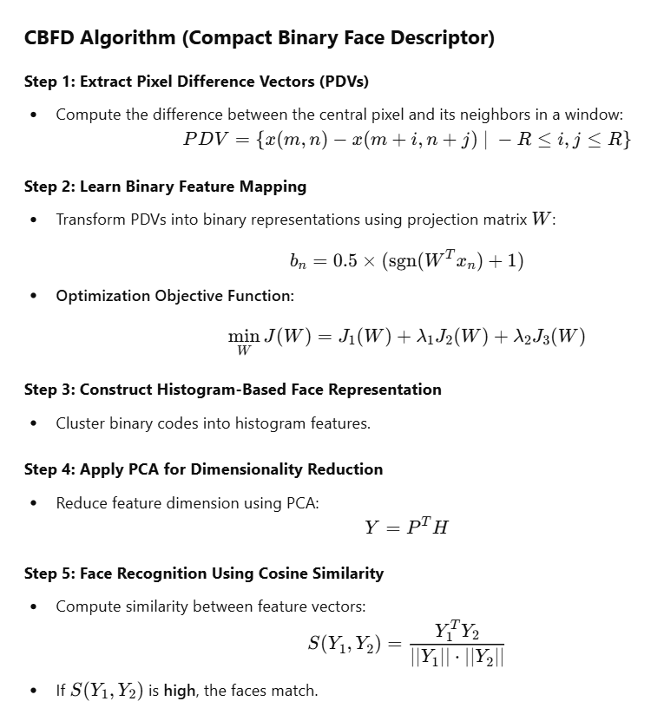
Algorithms for CBFD:

Slide 13
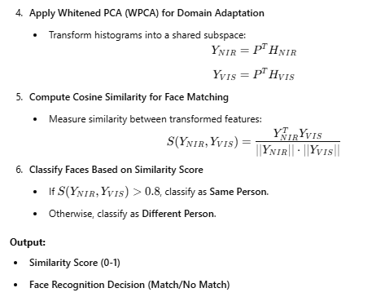

Slide 14
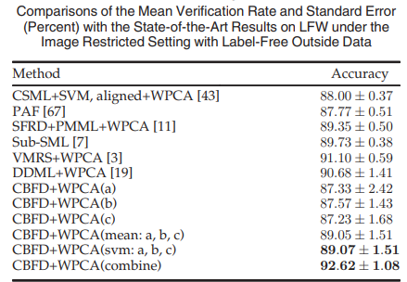
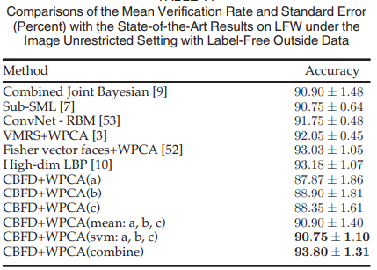
Results for CBFD:
CBFD achieves 92.62% accuracy in the LFW dataset (image-restricted setting) and 93.80% accuracy in the image-unrestricted setting, outperforming traditional methods. It provides a compact and efficient binary face descriptor, improving recognition performance while reducing storage and computation costs.

Slide 15
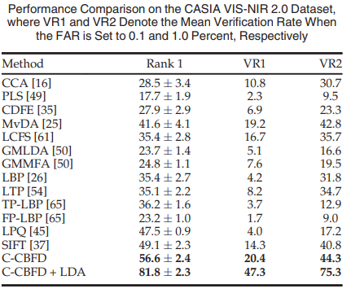
Results for C-CBFD:
C-CBFD achieves 81.8% accuracy on the CASIA NIR-VIS 2.0 dataset, outperforming traditional methods in heterogeneous face recognition. It effectively reduces the NIR-VIS modality gap, providing a compact and efficient binary descriptor, enhancing recognition accuracy while ensuring fast and scalable processing.

Slide 16
Application:
Smartphone Authentication: Ensures robust face unlock features even in challenging environments.
Retail Analytics: Helps recognize repeat customers despite variations in appearance over time.
Law Enforcement: Assists in identifying suspects from CCTV footage with varying conditions.

Slide 17
Conclusion:
The proposed Compact Binary Face Descriptor (CBFD) and Coupled CBFD (C-CBFD) methods provide efficient, compact, and highly accurate face recognition solutions. CBFD achieves state-of-the-art performance on the LFW dataset, while C-CBFD significantly improves hetero-geneous face recognition on the CASIA NIR-VIS 2.0 dataset.

Slide 18

SSS

